Slide 1
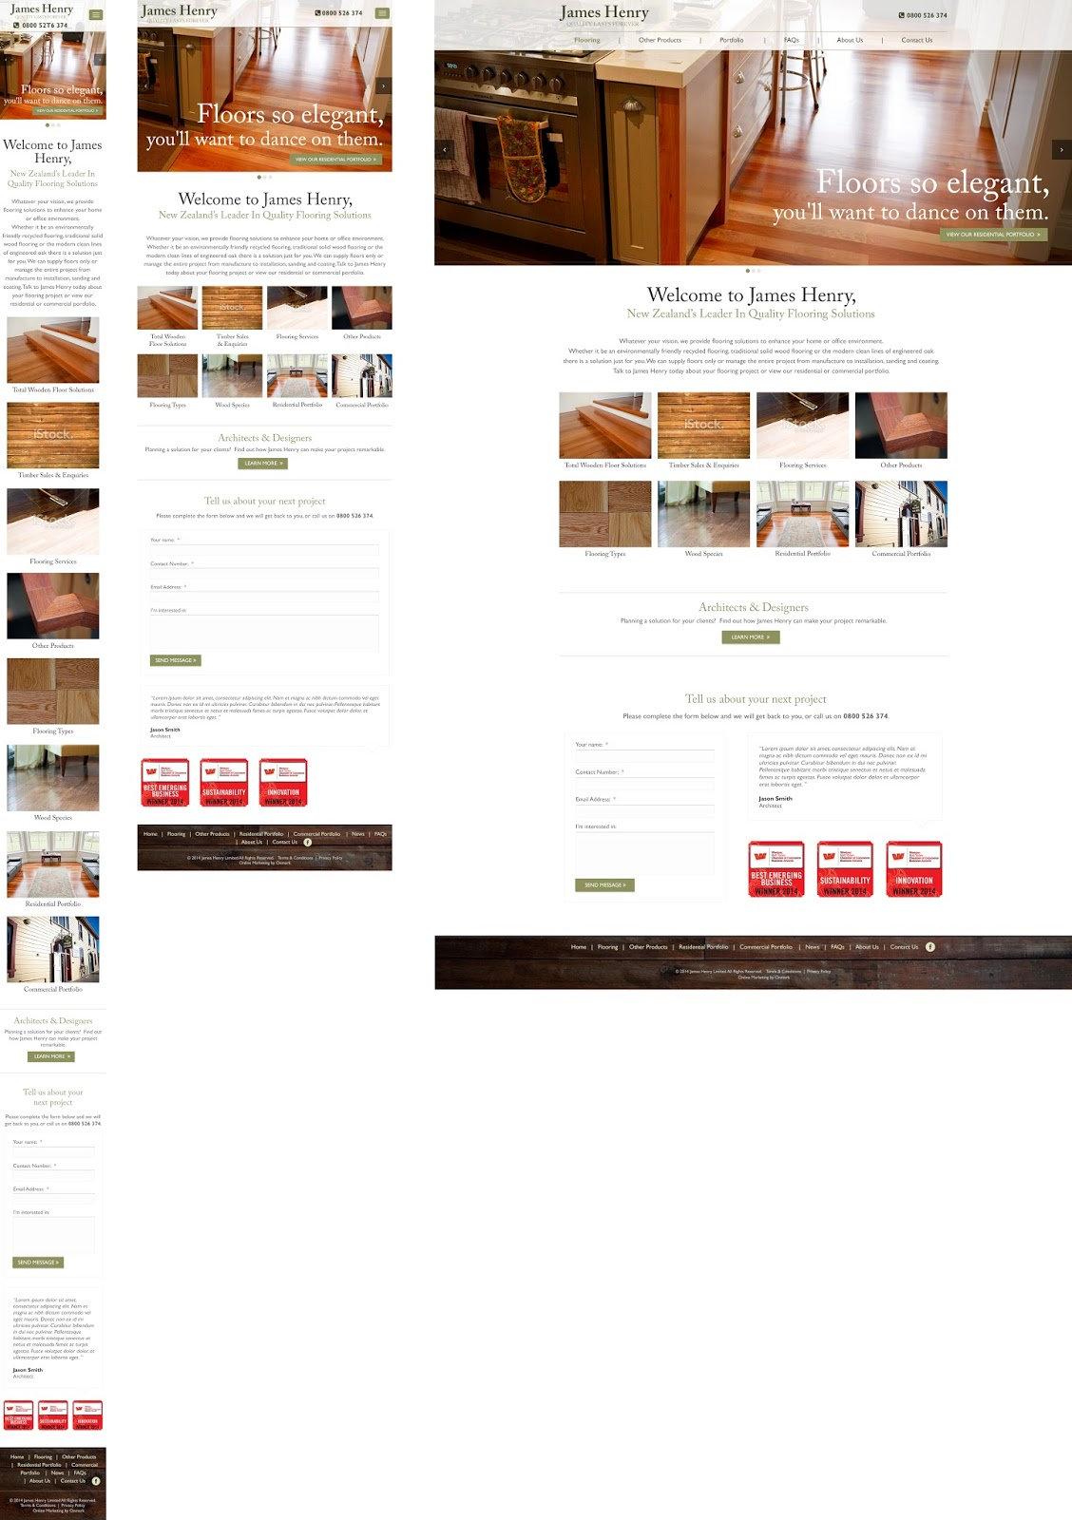





(Clickable smartphone link on smartphone browser) If responsive
TEMPLATE NAME: Home
PAGE NAME: Home
980 px (default)
768 px (Portrait Tablets)
480 px
320 px
Use mega menu- see slide 2
1200
Rotating images in banner. Auto-rotate then stop.
Linked to Architects & Designers page
Ability to have a new testimonial on each page
manageable via admin
Linked to http://www.onmark.co.nz/ Note: Online Marketing also needs to link to Onmark website.

Slide 2
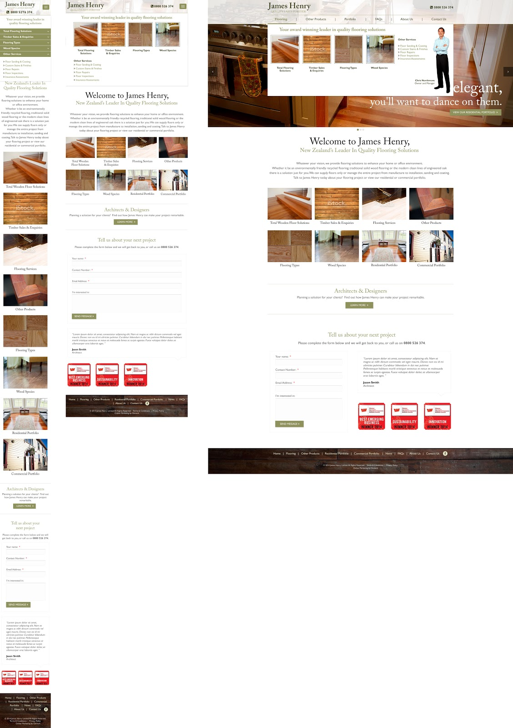
TEMPLATE NAME Home Page:
PAGE NAME: Home Page (Mega Menu)
980 px (default)
768 px (Portrait Tablets)
480 px
320 px
1200

Slide 3
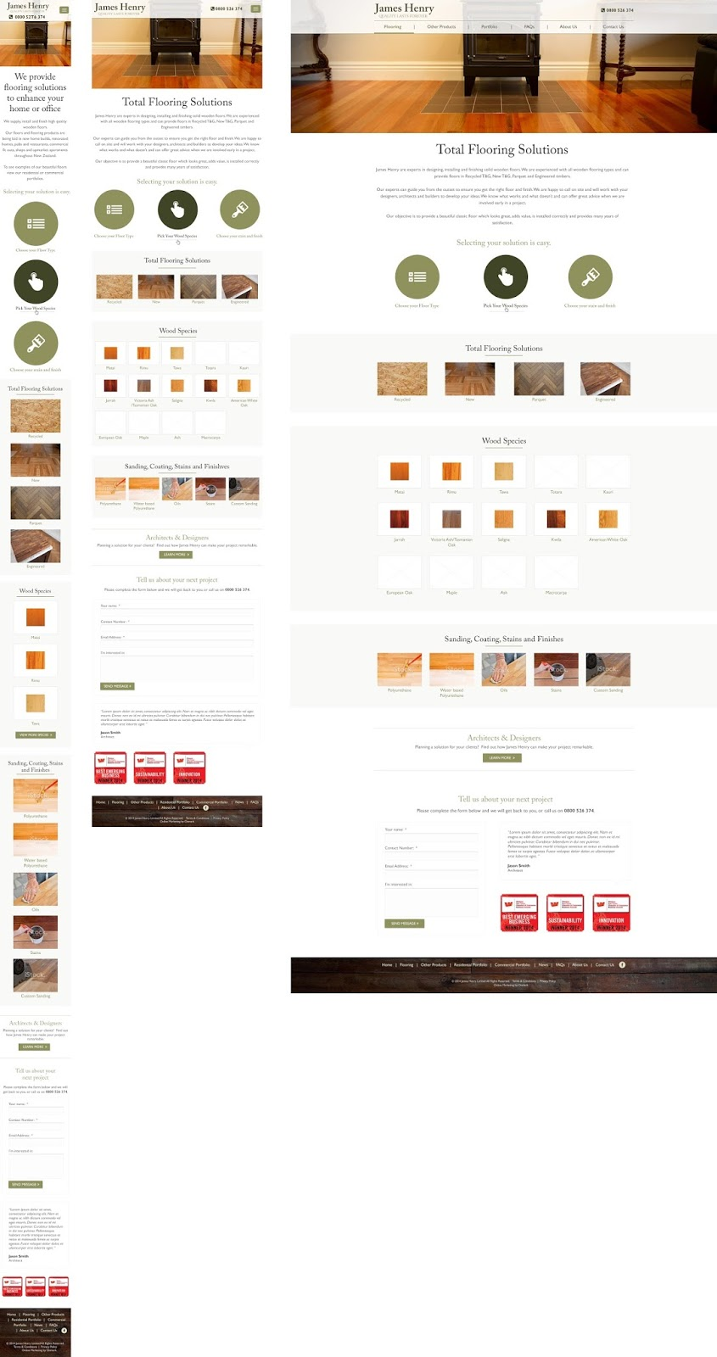
TEMPLATE NAME: Total Flooring Solutions
PAGE NAME: Total Flooring Solutions
980 px (default)
768 px (Portrait Tablets)
480 px
320 px
1200
These funnels need to be manageable via the admin
The three funnels should have the following anchors:
#types (To click down to section that says Total Flooring Solutions, which actually needs to be relabelled Floor Types.
#species (To click down to the Wood Species section)
#finish (To click down to the Sanding, Coating, Stains and Finishes section)
Need the ability to edit all text and images.
Also need the ability to add additional wood species (for example).
The Headings in the Three Sections should all link off to their relevant pages as well (Floor Types, Wood Species, Sanding Coating Stains & Finishes).
Notes:
Total Flooring Solutions

Slide 4
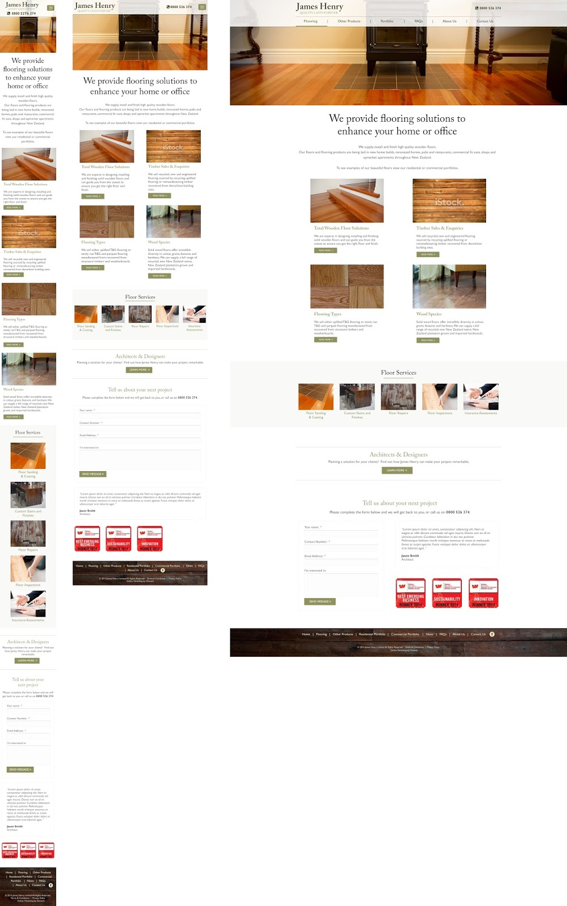
TEMPLATE NAME: Flooring
PAGE NAME: Flooring
980 px (default)
768 px (Portrait Tablets)
480 px
320 px
1200
Static image (with ability to change).
All content managed - links through to relevant pages.
Notes:
Flooring 2

Slide 5
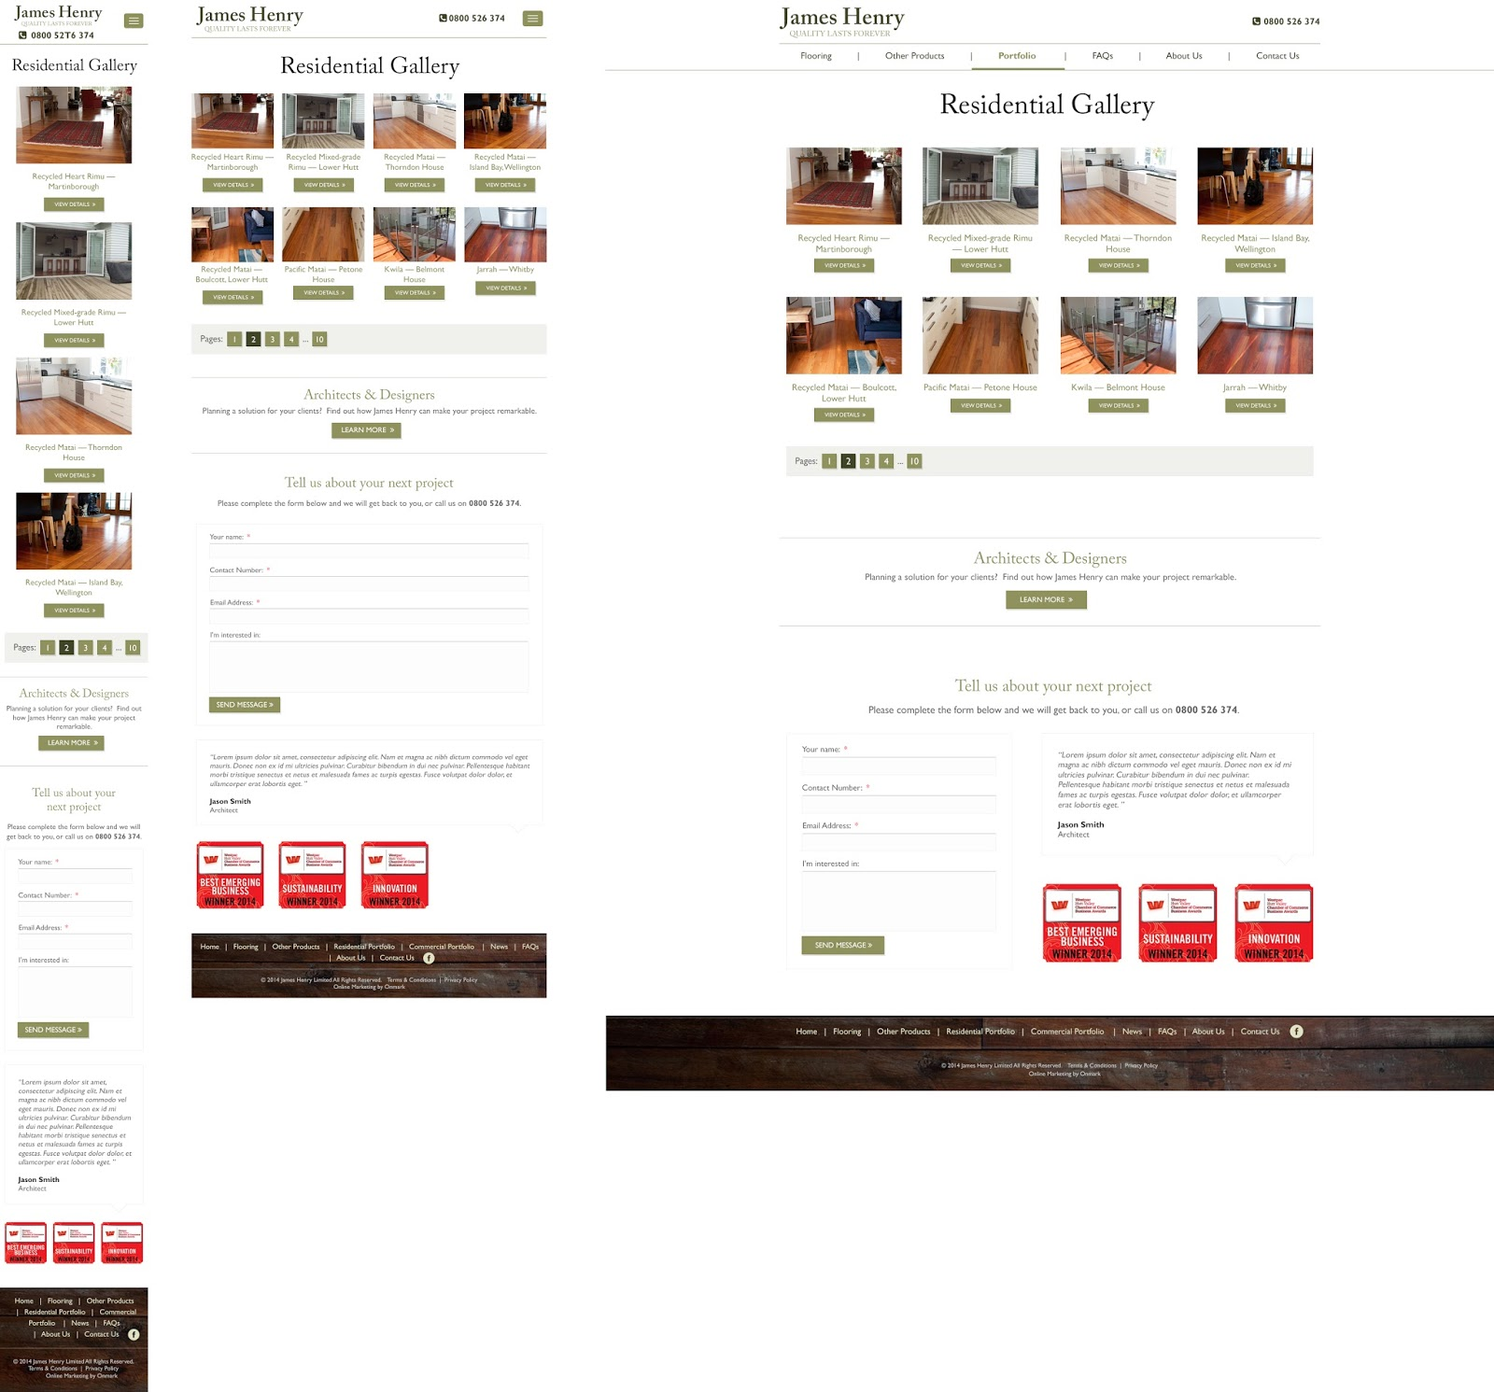
TEMPLATE NAME: Residential
PAGE NAME:
980 px (default)
768 px (Portrait Tablets)
480 px
320 px
1200
The gallery has to be manageable via the admin
Maybe create a module for gallery
When clicked, it should redirect user to the residential individual page. see slide 6
When Residential Portfolio is clicked, it should take you to a landing page (see RESIDENTIAL-11.jpg), then when one of the examples is selected, it will take you to RESIDENTIAL-INDIVIDUAL-11.jpg.
Please note: on the individual layout page, the client would prefer the gallery to pop-up in a light-box fashion rather than having thumbnails. We cannot design this as we are unsure what the Silverstripe functionality is like, but please use a light-box style gallery.
The Commercial Portfolio landing page and individual page should be laid out the same as Residential.
Notes:
Residential

Slide 6
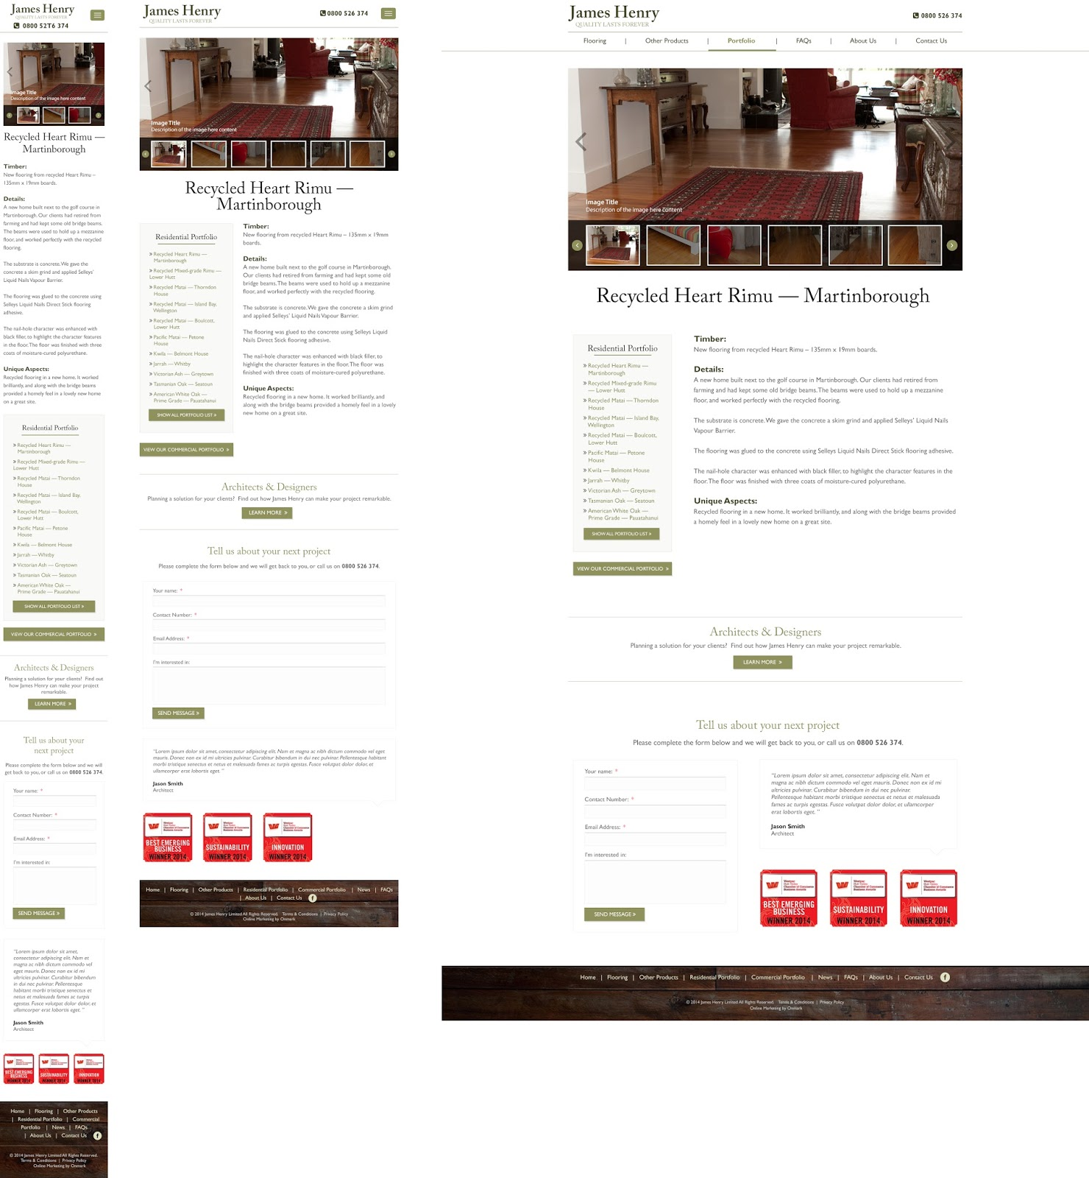
TEMPLATE NAME: Residential Individual -
PAGE NAME: residential Individual
980 px (default)
768 px (Portrait Tablets)
480 px
320 px
1200
Notes:
Residential Individual

Slide 7
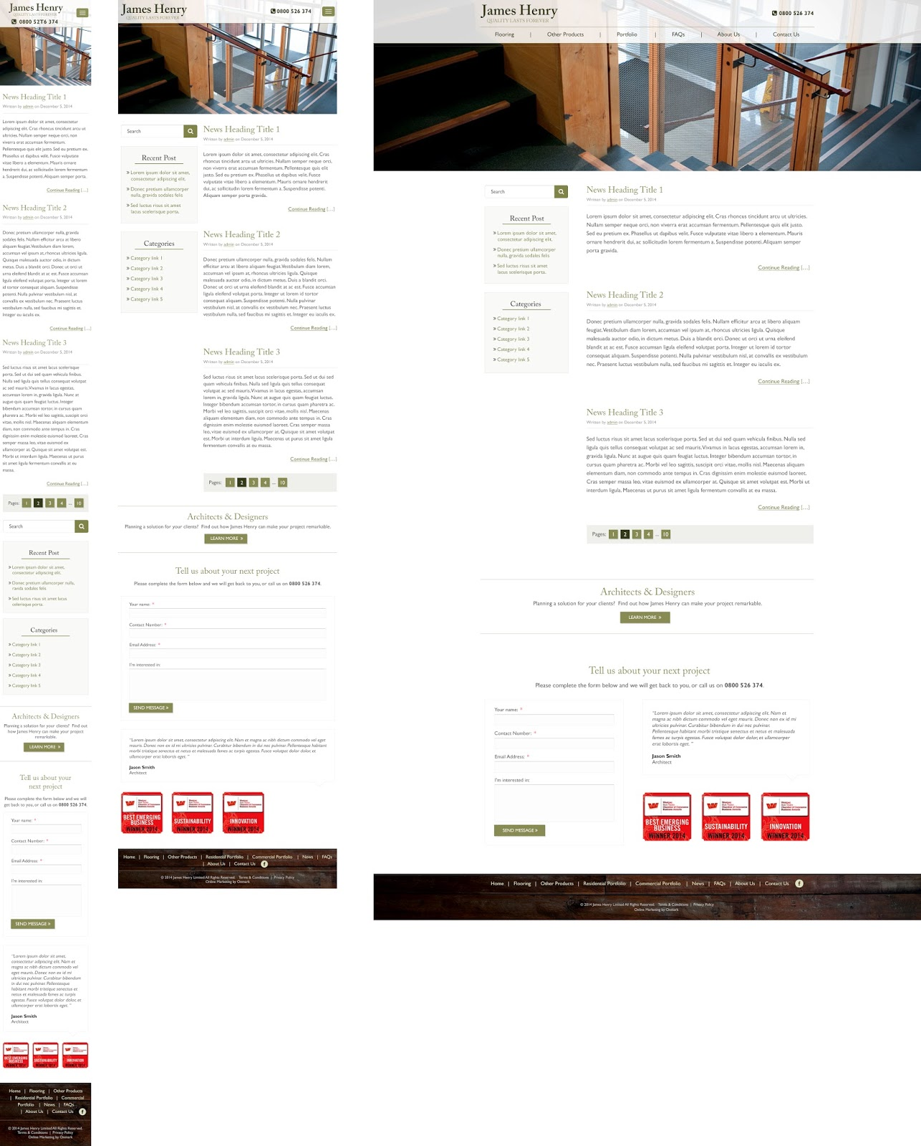
TEMPLATE NAME: News
PAGE NAME: News
980 px (default)
768 px (Portrait Tablets)
480 px
320 px
1200
- Display Recent Posts (doesn’t apply on FAQs page)
Notes:
News

Slide 8
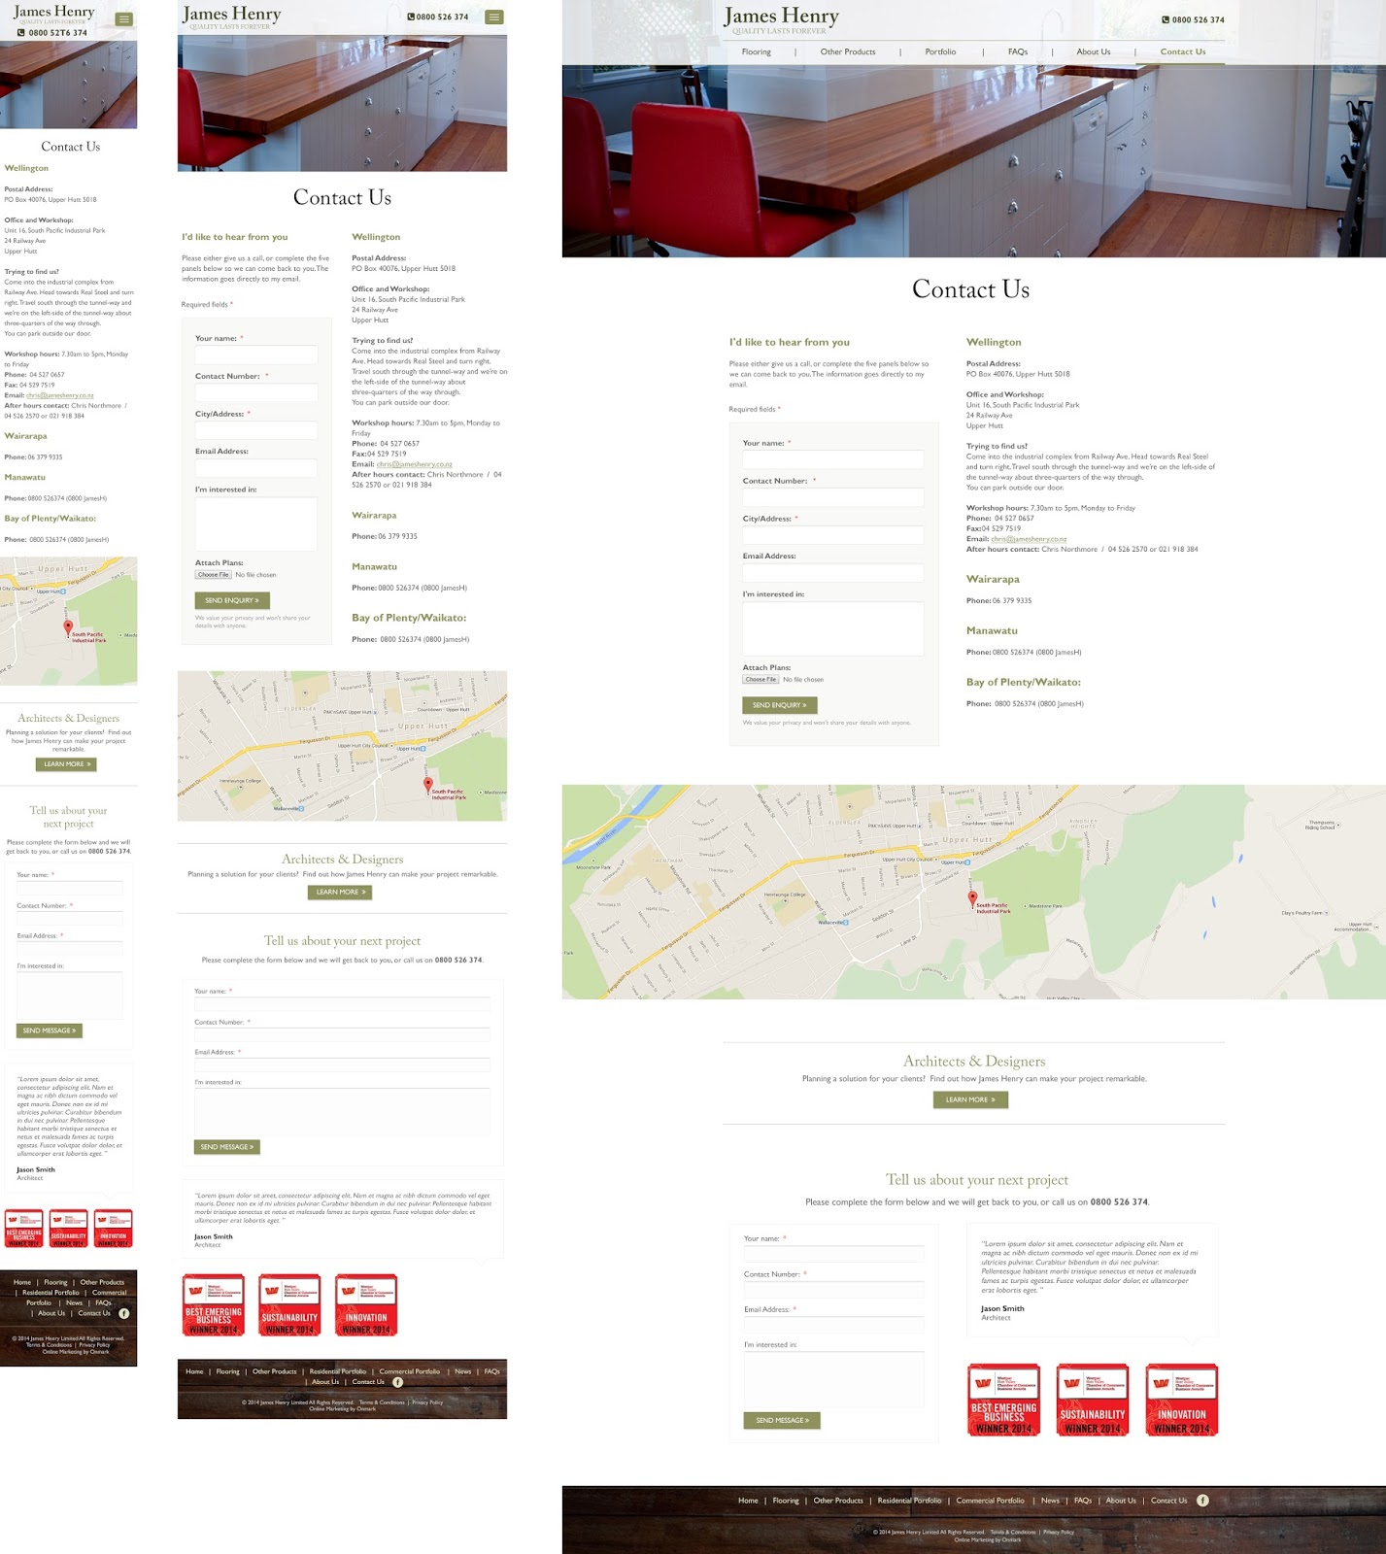
TEMPLATE NAME: Contact
PAGE NAME: Contact Us
980 px (default)
768 px (Portrait Tablets)
480 px
320 px
1200
Notes:
Contact

Slide 9
TEMPLATE NAME:
PAGE NAME:
980 px (default)
768 px (Portrait Tablets)
480 px
320 px
1200

Slide 10
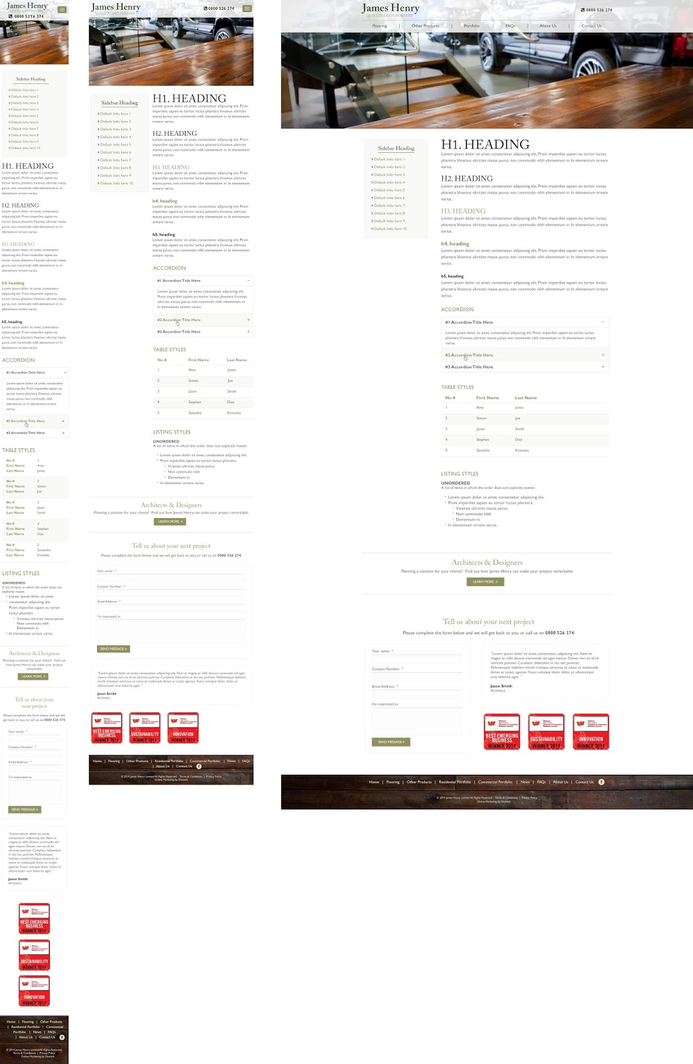
TEMPLATE NAME: Default CMS
PAGE NAME: CMS
980 px (default)
768 px (Portrait Tablets)
480 px
320 px
1200
Static banner (Use default, but allow ability to overlay a new image on each page).
Customisable sidebar menu (ability to add different menus depending on which page we are on).
Notes:
Default |CMS

Slide 11
TEMPLATE NAME:
PAGE NAME:
980 px (default)
768 px (Portrait Tablets)
480 px
320 px
1200

Slide 12
TEMPLATE NAME:
PAGE NAME:
980 px (default)
768 px (Portrait Tablets)
480 px
320 px
1200

Slide 13
TEMPLATE NAME:
PAGE NAME:
980 px (default)
768 px (Portrait Tablets)
480 px
320 px
1200

